Slide 1

INTRODUCTION TO NON MONOTONIC REASONING LECTURE 2: NON MONOTONIC LOGIC AND LOGIC PROGRAMMING
Computer Science Department
University of Verona - Italy

Slide 2
RECAP
We are in the state of challenging the exceptions in a factual way
NMR at a glance
Let us come back to provability

Slide 3
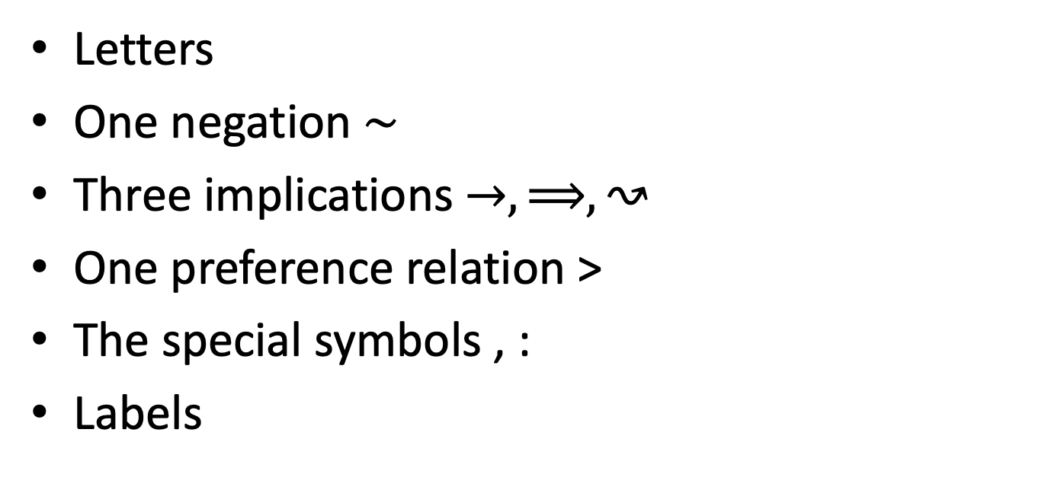
DEFEASIBLE LOGIC PARAPHERNALIA
Letters
One negation $∼$
Three implications $→,⟹,↝$
One preference relation >
The special symbols , :
Labels

Slide 4
FACTS AND RULES
Facts are literals
Rules are formed as one label upon an implication between a set of literals, separated by commas and one literal
Preferences are applied between two rules with opposite conclusions
A set of rules, facts, and prefences is named a defeasible theory

Slide 5
PROVING OR NOT PROVING?
In DL we have a different situation wrt to classical logic
We essentially have a difference between deriving formulae and concluding formulae
A formula is derived and concluded in different ways, but not every derived formula is consequently concluded

Slide 6
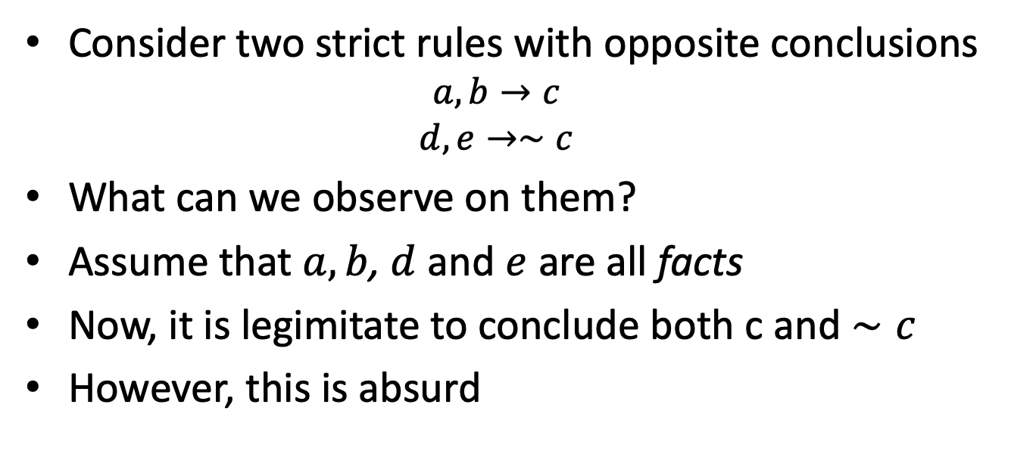
PREFERENCES
Consider two strict rules with opposite conclusions
$$a,b→c$$
$$d,e→∼c$$
What can we observe on them?
Assume that $a,b$, $d$ and $e$ are all facts
Now, it is legimitate to conclude both c and $∼c$
However, this is absurd

Slide 7
STRICT CONCLUSIONS
There is no way to make a theory consistent when the conclusions obtained by strict rules are contradictory
Therefore we introduce the principles of derivation and conclusions for strict part, that constitutes the monotonic subsystem of DL

Slide 8
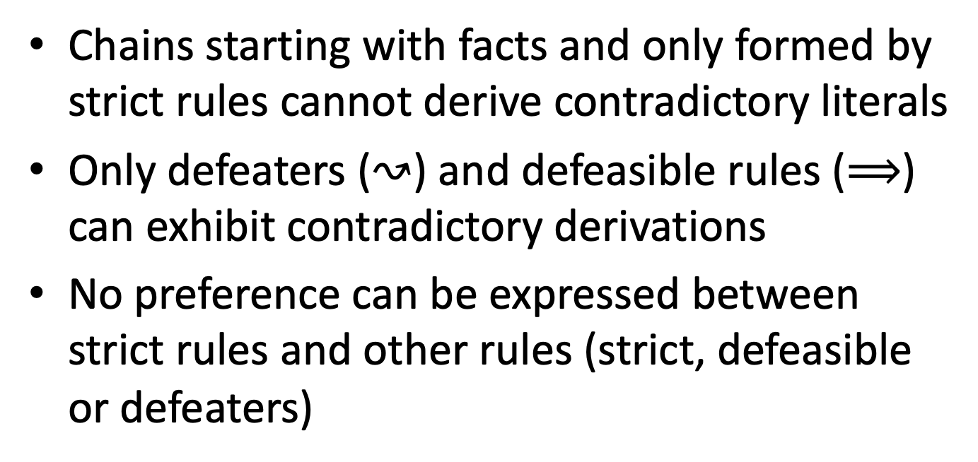
STRICT CONCLUSIONS (CTD)
Chains starting with facts and only formed by strict rules cannot derive contradictory literals
Only defeaters ($↝$) and defeasible rules ($⟹$) can exhibit contradictory derivations
No preference can be expressed between strict rules and other rules (strict, defeasible or defeaters)

Slide 9
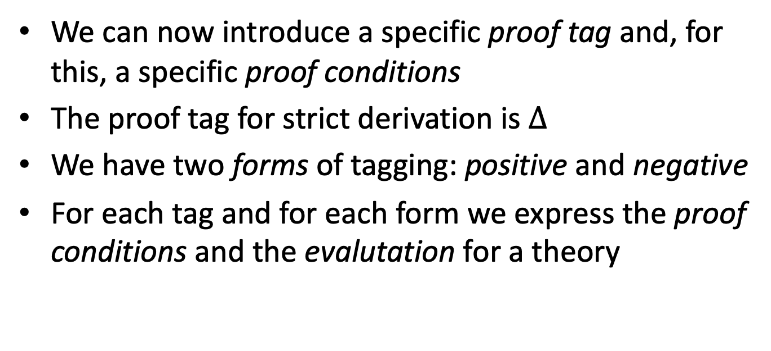
DEFEASIBLE THEORIES (STRICT PART)
We can now introduce a specific proof tag and, for this, a specific proof conditions
The proof tag for strict derivation is $Δ$
We have two forms of tagging: positive and negative
For each tag and for each form we express the proof conditions and the evalutation for a theory

Slide 10
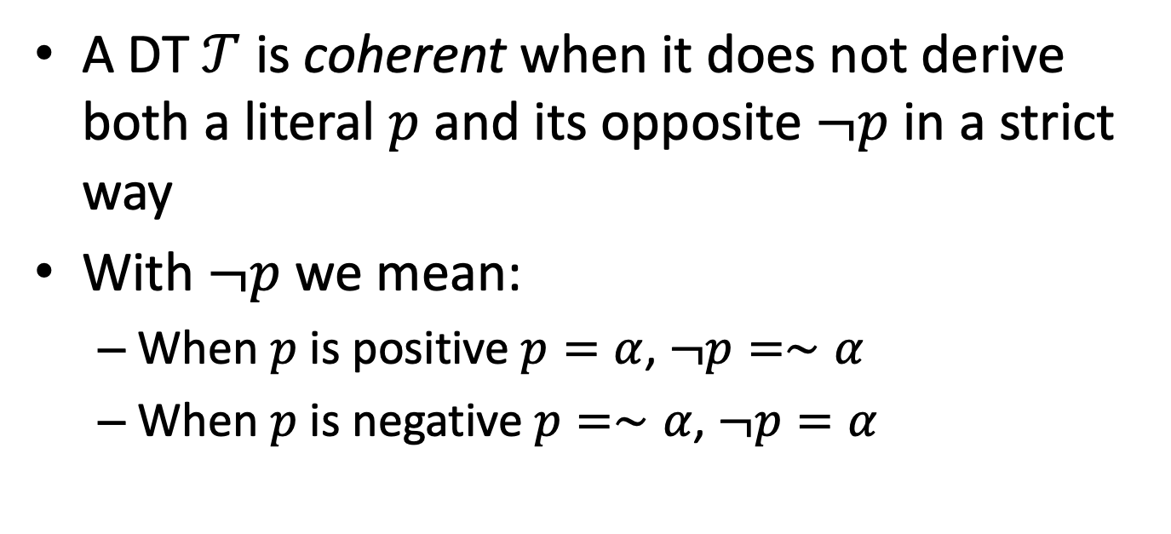
THEORY EVALUTATION
A DT $𝒯$ is coherent when it does not derive both a literal $p$ and its opposite $¬p$ in a strict way
With $¬p$ we mean:
When $p$ is positive $p=α$, $¬p=∼α$
When $p$ is negative $p=∼α$, $¬p=α$

Slide 11
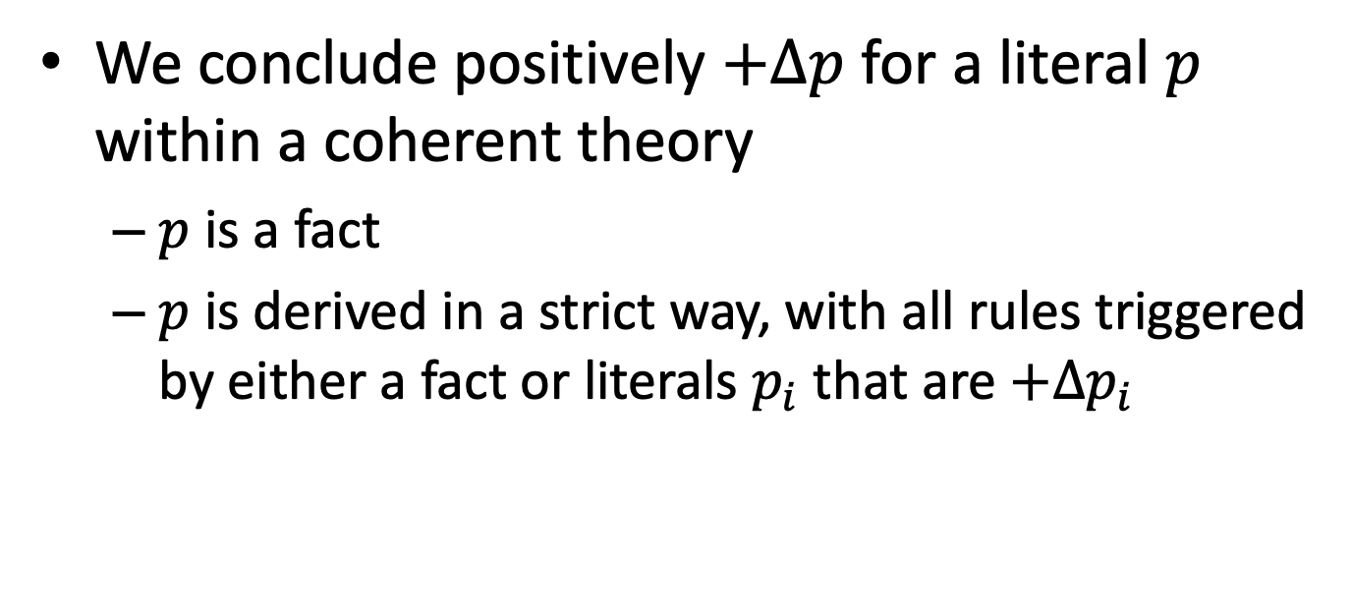
STRICT CONCLUSIONS
We conclude positively $+Δp$ for a literal $p$ within a coherent theory
$p$ is a fact
$p$ is derived in a strict way, with all rules triggered by either a fact or literals $p_{i}$ that are $+Δp_{i}$

Slide 12
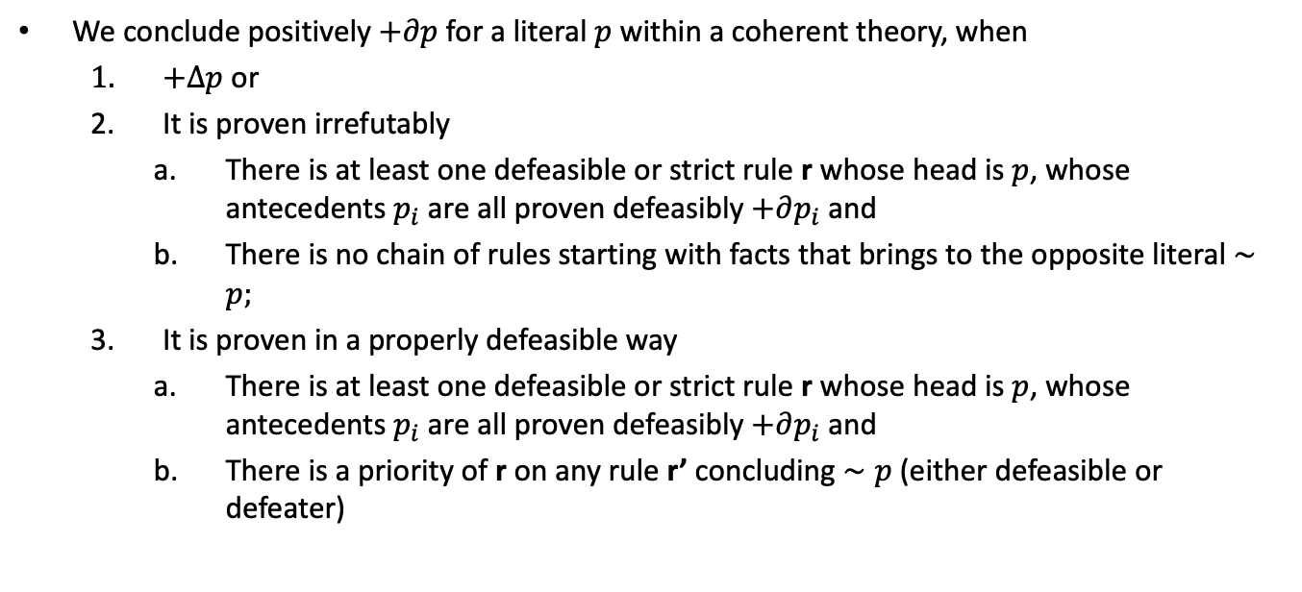
DEFEASIBLE CONCLUSIONS
We conclude positively $+∂p$ for a literal $p$ within a coherent theory, when
$+Δp$ or
It is proven irrefutably
There is at least one defeasible or strict rule r whose head is $p$, whose antecedents $p_{i}$ are all proven defeasibly $+∂p_{i}$ and
There is no chain of rules starting with facts that brings to the opposite literal $∼p;$
It is proven in a properly defeasible way
There is at least one defeasible or strict rule r whose head is $p$, whose antecedents $p_{i}$ are all proven defeasibly $+∂p_{i}$ and
There is a priority of r on any rule r’ concluding $∼p$(either defeasible or defeater)

Slide 13
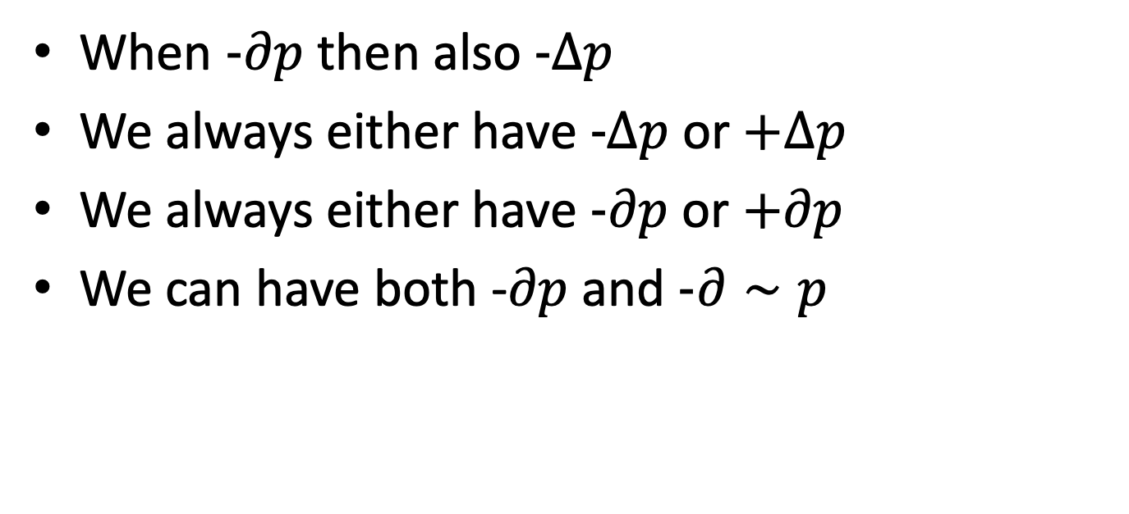
NEGATIVE TAGS
When $-∂p$ then also $-Δp$
We always either have $-Δp$ or $+Δp$
We always either have $-∂p$ or $+∂p$
We can have both -$∂p$ and $-∂∼p$

Slide 14
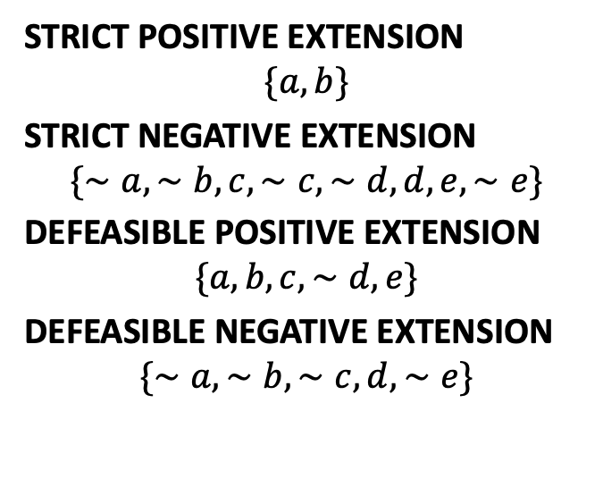

EXAMPLES: IRREFUTABLES
$$a$$
$$b$$
$$a,b⟹c$$
$$b,c⟹∼d$$
$$a, ∼d⟹e$$
STRICT POSITIVE EXTENSION
$$\{a,b\}$$
STRICT NEGATIVE EXTENSION
$$\{∼a,∼b,c,∼c,∼d,d,e,∼e\}$$
DEFEASIBLE POSITIVE EXTENSION
$$\{a,b,c,∼d,e\}$$
DEFEASIBLE NEGATIVE EXTENSION
$$\{∼a,∼b,∼c, d,∼e\}$$

Slide 15
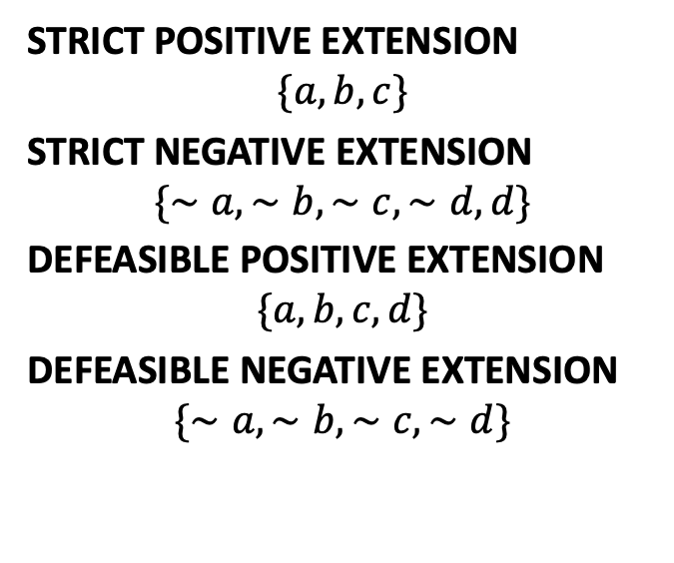

EXAMPLES: REFUTABLES
$$a$$
$$b$$
$$c$$
$$r1:a,b⟹d$$
$$r2:b,c⟹∼d$$
$$r1>r2$$
STRICT POSITIVE EXTENSION
$$\{a,b,c\}$$
STRICT NEGATIVE EXTENSION
$$\{∼a,∼b,∼c,∼d,d\}$$
DEFEASIBLE POSITIVE EXTENSION
$$\{a,b,c,d\}$$
DEFEASIBLE NEGATIVE EXTENSION
$$\{∼a,∼b,∼c,∼d\}$$

Slide 16
SOME COMPUTATIONA ISSUES TO DEAL WITH
Does this work?
Is there a general implementation?
Is there a general method?

Slide 17
PROLOG

Slide 18
Prolog
A logic programming language created in 1972
PROgramming in LOGic
Restricted to Horn clauses
Head:- body
Inference
Backward chaining
Closed world assumption

Slide 19
Knowledge Base-facts
Knowledgebase can have facts:
woman(mia).
playsguitar(jane).
...

Slide 20
Knowledge Base-facts
Knowledgebase can have facts:
woman(mia).
playsguitar(jane).
Consulting the KB is done in the Interpreter window:
Prolog listens to your queries and answers:
?- woman(mia). //asking if mia is a woman
yes

Slide 21
Consulting
Consulting the KB:
Prolog listens to your queries and answers:
?- woman(mia)
yes
?- woman(jane)
no
doesn’t follow from KB
?- woman(alisa)
no
doesn’t know anything about alisa

Slide 22
KnowledgeBase - rules
male(yasin).
female(aliye).
male(yusuf).
mortal(X) :- person(X).
person(X) :- female(X).
person(X) :- male(X).
head := body means body => head
e.g. person ( X) => mortal (X)

Slide 23
KnowledgeBase - rules
You can type
?- debug.
and enter a debug mode where you can see what rule is used in the matching.
male(yasin).
female(aliye).
male(yusuf).
mortal(X) :- person(X).
person(X) :- female(X).
person(X) :- male(X).
If you save these in a file: mortal.pro (a prolog program), you can TELL these to the interpreter via (or when you click on file name and select run-as single interpreted file, when listener window is closed):
?- consult(mortal).
Yes
If you type “listing”, Prolog will list all the facts and rules you just “read in” (consulted).
?- listing.
male(yasin)
...

Slide 24
KnowledgeBase - rules
male(yasin).
female(aliye).
male(yusuf).
mortal(X) :- person(X).
person(X) :- female(X).
person(X) :- male(X).
If you save these in a file: mortal.pro (a prolog program), you can TELL these to the interpreter via:
?- consult(mortal).
Yes
...
Now we can test the program inside the Listener with prolog queries:
?- mortal(araba).
no
?- mortal(yasin).
yes

Slide 25
Rules - Logical AND
dances(vincent) :- happy(vincent) , listensToMusic(vincent).
, is used to indicate Logical AND
Equivalent to:
happy(vincent) ∧ listensToMusic(vincent) => dances(vincent)
“Vincent dances if he listens to music and he is happy”.
Other example:
father(X,Y) :- parent(X,Y) , male(X).

Slide 26
Rules - Logical OR
dances(john) :- happy(john).
dances(john) :- listensToMusic(john).
Indicates LOGICAL OR
Equivalent to:
happy(john) ∨ listensToMusic(john) => dances(john)
“John dances either if he listens to music, or if he is happy.”
This can also be stated as:
dances(john) :- happy(john) ; listensToMusic(john).
where ; indicates OR.

Slide 27
Consulting
File:
woman(mia).
woman(jody).
woman(yolanda).
loves(vincent,mia).
loves(marcellus,mia).
In the interpreter window (?):
?- woman(X).
X = mia

Slide 28
Consulting
woman(mia).
woman(jody).
woman(yolanda).
loves(vincent,mia).
loves(marcellus,mia).
?- woman(X).
X = mia
?- ; (remember that ; means OR
so this query means: “are there any more women?”)
X = jody
?- ;
X = yolanda
?- ;
no ( No other match is possible)

Slide 29
Inference
woman(mia).
woman(jody).
woman(yolanda).
loves(vincent,mia).
loves(marcellus,mia).
?- loves(marcellus,X),woman(X).
...
Note: we are querying for a conjunct.

Slide 30
loves(vincent,mia).
loves(marcellus,mia).
loves(pumpkin,honey_bunny).
loves(honey_bunny,pumpkin).
jealous(X,Y) :- loves(X,Z),loves(Y,Z).
Any jealous people?
?- jealous(marcellus,W).
apply Generalized Modus Ponens
...
Any other?

Slide 31
Wildcard
In Prolog predicates, underscore (_) is the wildcard (matches anything):
Mother(M,C) :- Person(C,_,M,_,_).
where Person is defined as
Person(name, gender, mother, father, spouse).
It means, Mother(M,C) holds, if the predicate Person holds for C and M in the right positions, with anything else for the other parts.

Slide 32
assert, retract, tell, told...
You can dynamically add new facts and rules into the interpreter (not into the Prolog file) by assert:
?- assert(person(ali,male,ayse,veli,fatma)).
You can dynamically retract facts within the interpreter (not into the Prolog file) by retract:
?- retract(person(ali,male,ayse,veli,fatma)).
You can write into a file by tell:
?- tell(‘out.txt’). //now anything you write goes to that file
You can now close that file by told:
?- told. //stops the output

Slide 33
Proof Search – How does Prolog search?
Suppose we are working with the following knowledge base
f(a).
f(b).
g(a).
g(b).
h(b).
k(X) :- f(X),g(X),h(X).

Slide 34
f(a).
f(b).
g(a).
g(b).
h(b).
k(X) :- f(X),g(X),h(X).
Pose the query k(X).
You will probably see that there is only one answer to this query, namely k(b),but how exactly does Prolog work this out?

Slide 35
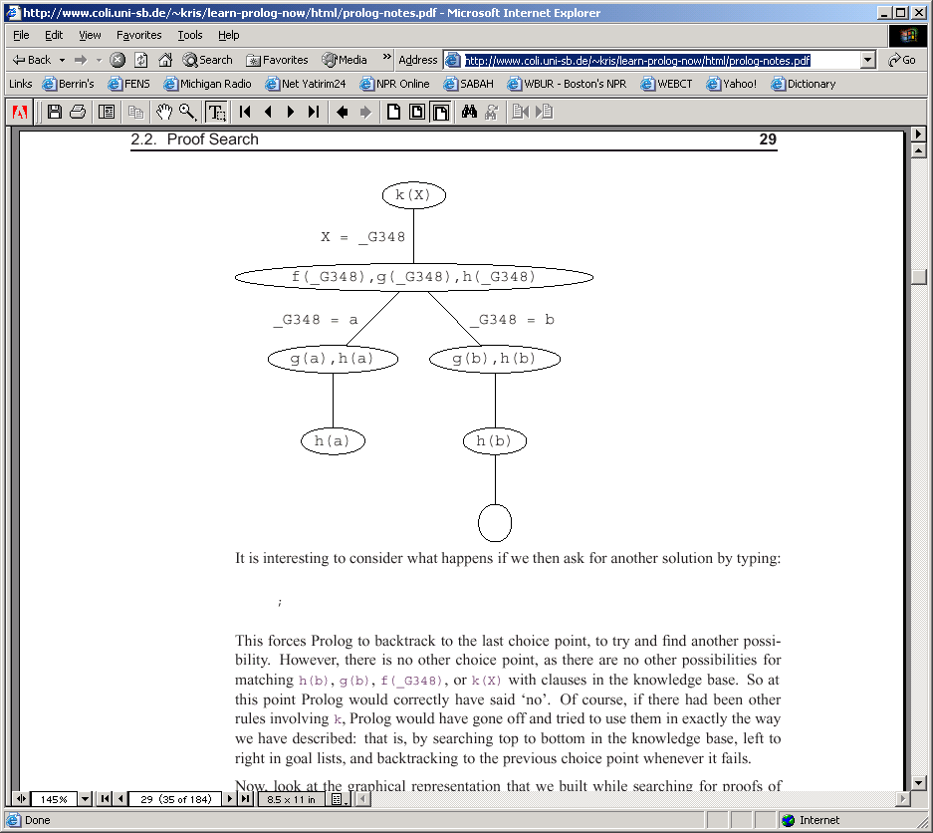
Backtracking search

Slide 36
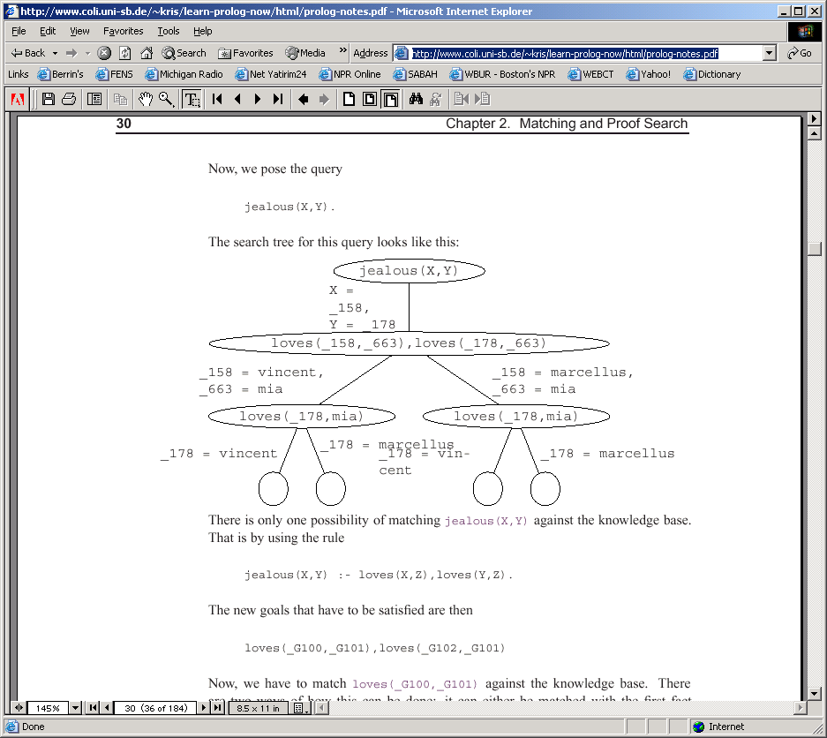
Backtracking search

Slide 37
4 leave nodes with an empty goal list
four ways for satisfying the query.
the variable instantiation for each of them can be read off the path from the root to the leaf node.
1. X = \_158 = vincent and Y = \_178 = vincent
2. X = \_158 = vincent and Y = \_178 = marcellus
3. X = \_158 = marcellus and Y = \_178 = vincent
4. X = \_158 = marcellus and Y = \_178 = marcellus
So who is jealous? How to fix it?

Slide 38
Consulting
woman(mia).
woman(jody).
woman(yolanda).
?- woman(X).
X = mia
?- ;
X = jody
... Any better way?

Slide 39
Consulting
woman(mia).
woman(jody).
woman(yolanda).
loves(vincent,mia).
loves(marcellus,mia).
woman_list:-
write(‘Known women are:'),nl,
woman(X),
write(X),nl,
fail.
The first match (mia) is written and then the rule fails, forcing Prolog to backtrack and try different matches (jody, yolanda,...)

Slide 40
Woman_list
write(‘Known women are:'), nl, woman(X), write(X),nl,fail
X=mia
X=jody
write(mia),nl,fail
write(jody),nl,fail
fail
fail

Slide 41
Negation and Cut
p(X) :- a(X).
p(X) :- b(X),c(X),d(X),e(X).
p(X) :- f(X).
a(1).
b(1).
c(1).
b(2).
c(2).
d(2).
e(2).
f(3).
If we pose the query p(X) we will get the following responses:
X =1;
X =2;
X =3;
no

Slide 42
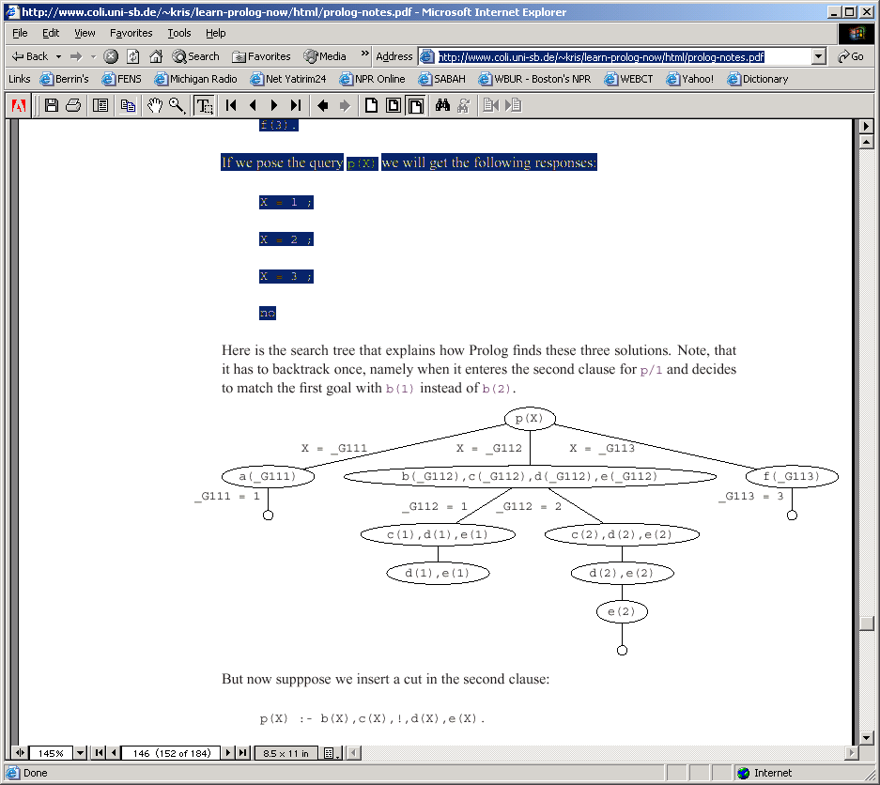

Slide 43
Cuts
But now supppose we insert a cut in the second clause:
p(X) :- b(X),c(X),!,d(X),e(X).
If we now pose the query p(X) we will get the following responses:
X =1;
no

Slide 44
Cuts
The ! goal succeeds (it always does) and commits us to all the choices we have made so far.
All nodes above the cut, up to the one containing the goal that led to the selection of the clause containing the cut (p in this case) are blocked.
if we were allowed to try the third rule, we could also generate the solution X=3. But we can't do this: the cut has committed us to using the second rule.

Slide 45
Cuts
For example, in a rule of the form:
q :- p1,...,pn,!,r1,...,rm
Once we reach the the cut, it commits us to using this particular clause for q and it commits us to the choices made when evaluating p1,...,pn (remember as: everything to the left of the cut is fixed).
However, we are free to backtrack among the r1,...,rm and we are also free to backtrack among alternatives for choices that were made before reaching the goal q.

Slide 46
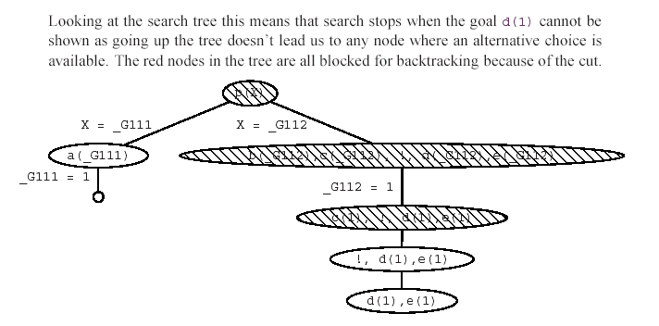

Slide 47
Why are cuts useful
Imagine a max function that returns the max of two numbers:, defined as:
max(X,Y,Y) :- X =< Y. max(X,Y,X) :- X>Y.
If max(3,4,Y) is queried, the program will correctly set Y=4.
But now consider what happens if at some stage backtracking is forced. The program will try to resatisfy max(3,4,Y) using the second clause. Of course, this is completely pointless: the maximum of 3 and 4 is 4 and that's that. There is no second solution to find. To put it another way: the two clauses in the above program are mutually exclusive: if the first succeeds, the second must fail and vice versa. So attempting to resatisfy this clause is a complete waste of time.
Solution:
max(X,Y,Y) :- X =< Y,!. max(X,Y,X) :- X>Y.

Slide 48
Exceptions by Cut-Fail
We want to say that vincent likes all burgers except for big_kahuna_burgers. Lets try:
enjoys(vincent,X) :- big_kahuna_burger(X),!,fail.
enjoys(vincent,X) :- burger(X).
burger(X) :- big_mac(X).
burger(X) :- big_kahuna_burger(X).
burger(X) :- whopper(X).
big_mac(a).
big_kahuna_burger(k).
big_mac(c).
whopper(d).

Slide 49
When we pose the query enjoys(vincent,k)
- the first rule applies (enjoys := big_kahuna...), and we reach the cut.
- this commits us to the choices we have made, in particular (enjoy using the second rule and X = k), blocks access to the second rule. But then we hit fail. This tries to force backtracking, but the cut blocks it, and so our query fails.
But enjoys(vincent,X) also fails, which is not what we want.
See the right solution in the next slide.

Slide 50
Better way: Negation as Failure
We want to say:
“ Vincent enjoys X if X is a burger and X is not a Big Kahuna burger. “
Try:
neg(Goal) :- Goal,!,fail.
neg(Goal).
enjoys(vincent,X) :- burger(X), neg(big_kahuna_burger(X)).

Slide 51
If-Else
We can achieve the same result using an if-else construct (but cuts are so widely used that you needed to learn what they are)
if A then B else C is written as ( A -> B ; C).
- to Prolog this means: try A.
- if you can prove it, go on to prove B and ignore C.
- if A fails, however, go on to prove C ignoring B.
The max predicate using the if-then-else construct looks as follows:
max(X,Y,Z) :- ( X =< Y -> Z = Y; Z = X ).

Slide 52
Lists
Similar to LISP:
?- [Head|Tail] = [mia, vincent, june].
Head = mia
Tail = [vincent, june].
To access the 2nd element of a list, you can type:
?- [ _ , X|Tail] = [mia, vincent, june].
X = vincent
Writing a predicate to test membership of X in a List:
Member(X, [X|T] ).
Member(X, [Y|T] ) :- Member(X,T).
1st rule says, X is a member of a list if it is the first element.
2nd rule says, X is a member of a list if it is not the first element, but is a member of the rest.

Slide 53
Some important rules from gene.pro
delete(X) :-
retract(person(X,_,_,_,_)).
close :-
retractall(person(_,_,_,_,_)).
save(FileName) :-
tell(FileName),
listing(person),
told.

Slide 54
Some important rules from gene.pro
%define all possible relation(ship)s in a list
relations( [parent, wife, husband, ancestor, descendent, full_sibling,
half_sibling, sibling, sister, brother, step_sibling, uncle,
aunt, mother, father, child, son, daughter, step_parent,
step_child, step_mother, step_father, step_son, step_daughter,
nephew, niece, cousin, grandmother, grandfather, grandparent,
grandson, granddaughter, grandchild]).
%R(X,Y) holds if R is a relation
relation(R, X, Y) :-
relations(Rs), member(R,Rs), % if R is a relation(ship)
Q =.. [R,X,Y], % results in Q=R(X,Y)
call(Q). %tests R(X,Y)

